Slide 1
Kannada MNIST | Kaggle
Yazhuo Ma

Slide 2
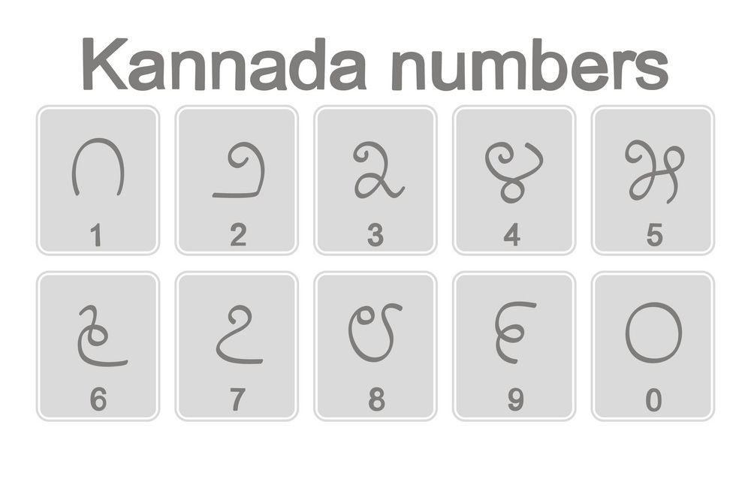
Goal:
How to teach meachine to recognize Kannada numbers?

Slide 3
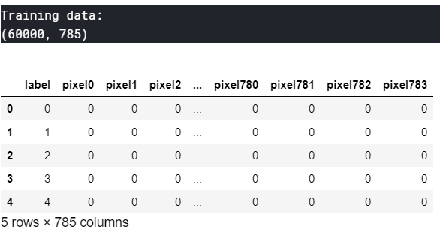
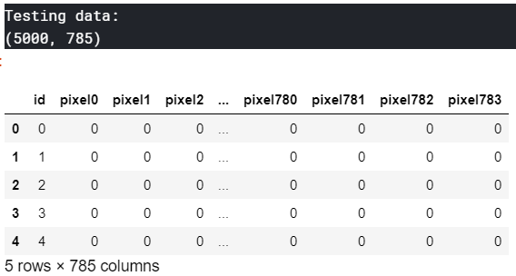
Data Exploration
Each image is 28 pixels in height and 28 pixels in width, for a total of 784 pixels in total. Each pixel has a single pixel-value associated with it, indicating the lightness or darkness of that pixel, with higher numbers meaning darker. This pixel-value is an integer between 0 and 255, inclusive.

Slide 4

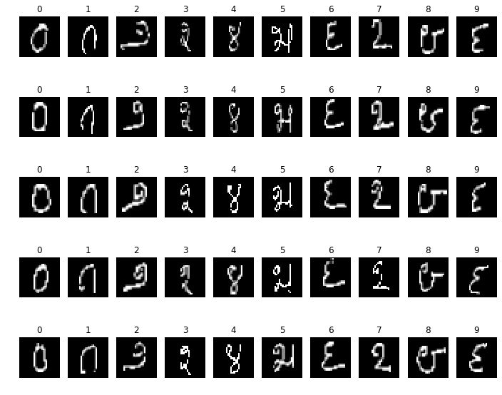
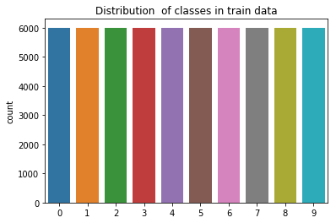
Data Exploration
Check missing values
Preview first 50 images
Check distribution of numbers

Slide 5
SVM
Convolutional Neural Networks(CNN)

Slide 6
SVM
Problem: It takes very long time to train with all the train data.
Solution: Randomly choose 10000 rows from train data and figure out a method with shortest training time and best accuracy

Slide 7
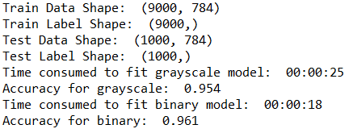
SVM
Plan A - Grayscale Model
Plan B - Binary Model

Slide 8
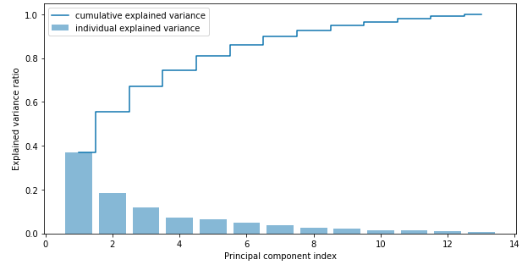
Dimension Reduction
- Principal Component Analysis(PCA)
To compress a dataset onto a lower-dimensional feature subspace with the goal of maintaining most of the relevant information. So that we can train our model quicker and keep high accuracy.
The first principal component alone accounts for approximately 40% of the variance.

Slide 9
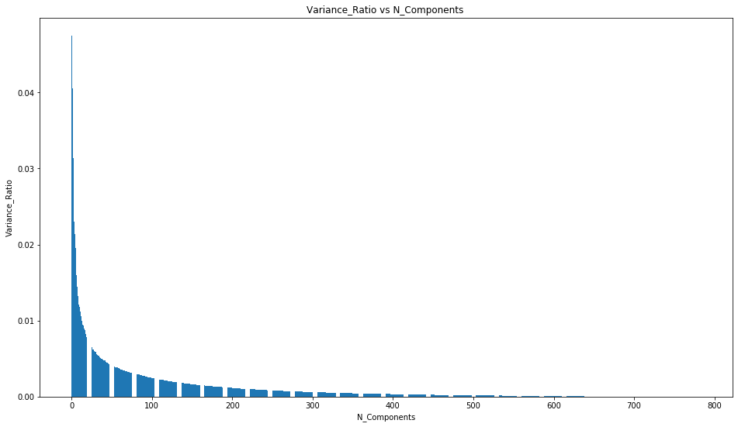
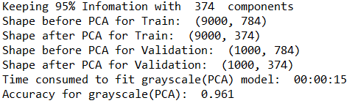
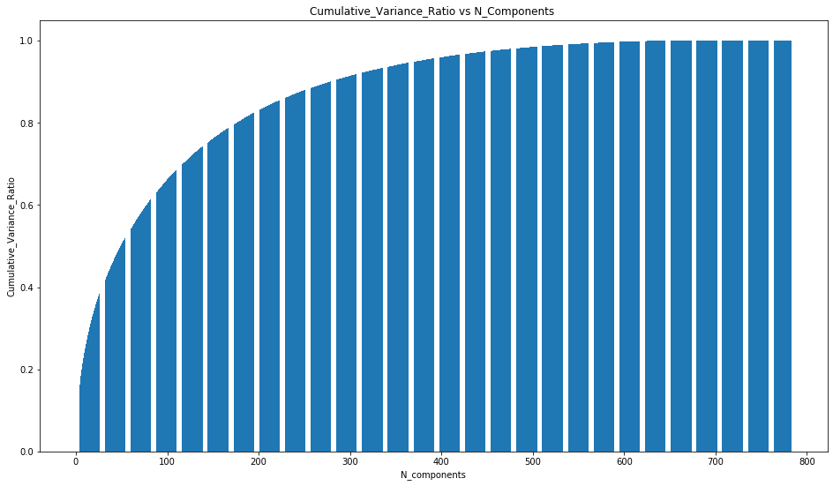
SVM
Plan C - Grayscale(PCA) Model

Slide 10
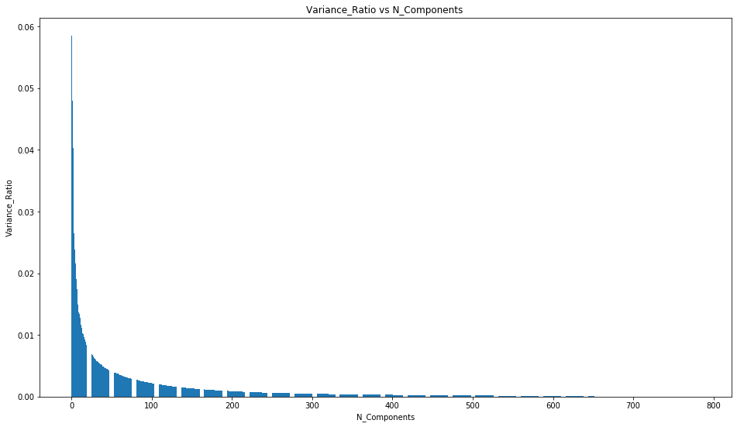
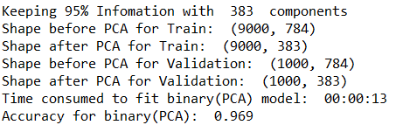
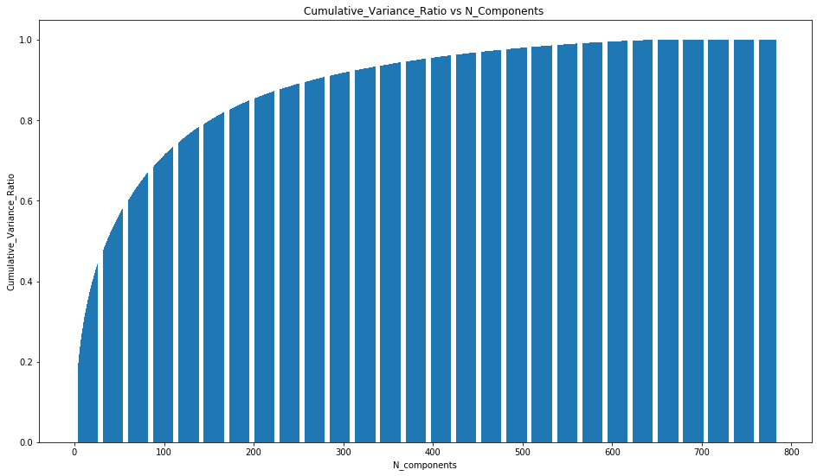
SVM
Plan D - Binary(PCA) Model

Slide 11
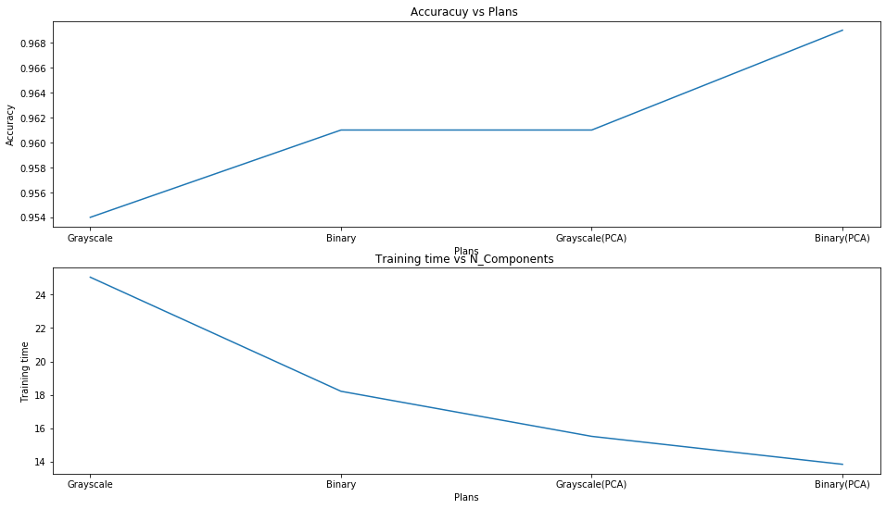
SVM
Compare 4 plans visually
Binary(PCA) model has highest accuracy as well as the shortest training time!

Slide 12
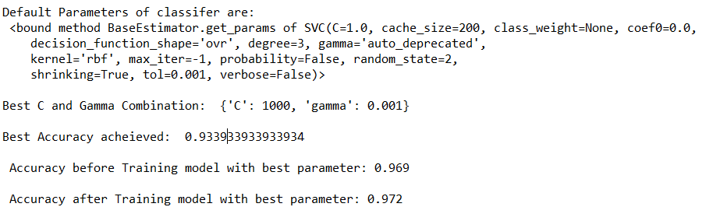

SVM
Parameter Selection for binary(pca) by GridSearchCV

Slide 13
Convolutional Neural Networks(CNN)

Slide 14

CNN
A Convolutional Neural Network (ConvNet/CNN) is a Deep Learning algorithm which can take in an input image, assign importance (learnable weights and biases) to various aspects/objects in the image and be able to differentiate one from the other.

Slide 15
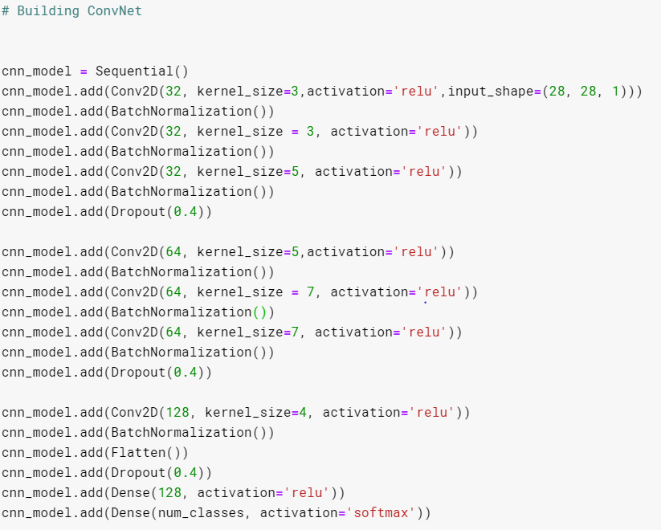
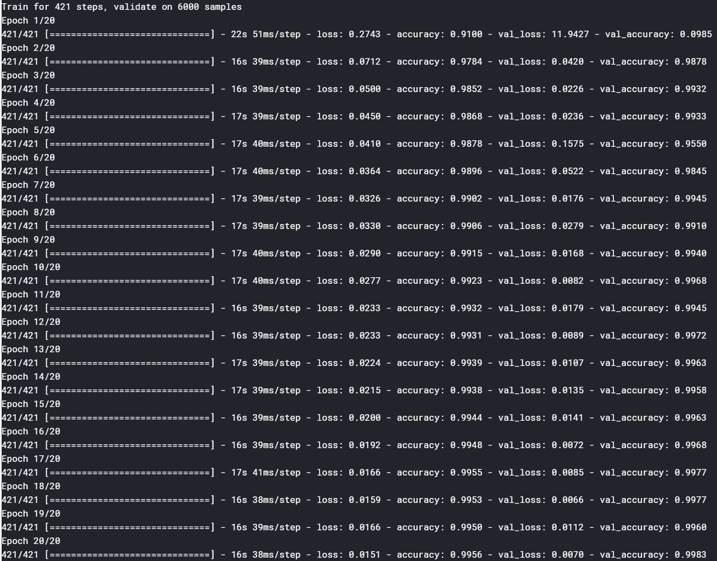
CNN
My best Model(3355774):
My result for a single net(20 epochs):

Slide 16
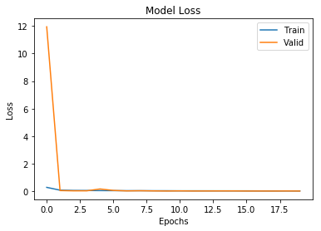
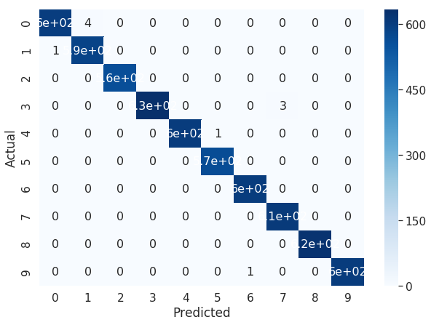
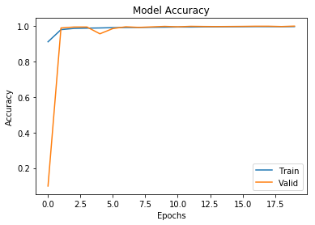
CNN
Analysis model visually:

Slide 17

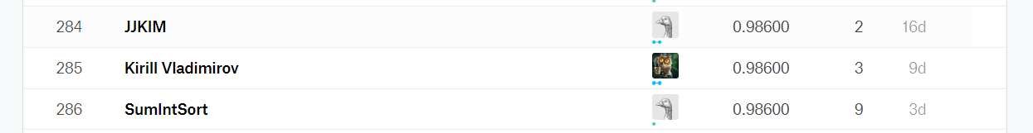
CNN
Problem
Accuracy is not high enough to get a good rank in Kaggle Leaderboard.
Possible Solutions
Parameter Tuning
Ensemble Prediction
Pseudo - Labeling
Data Augmentation

Slide 18
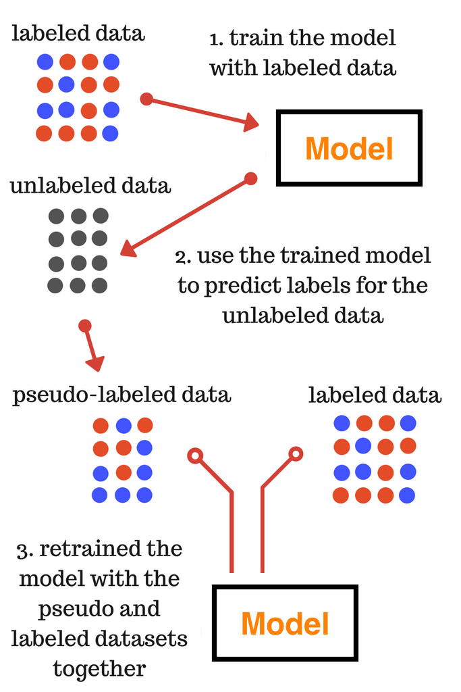
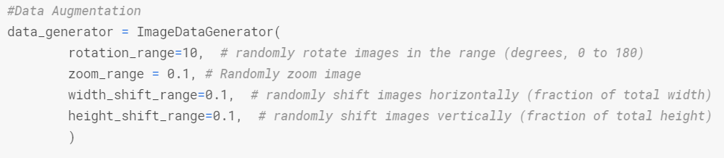
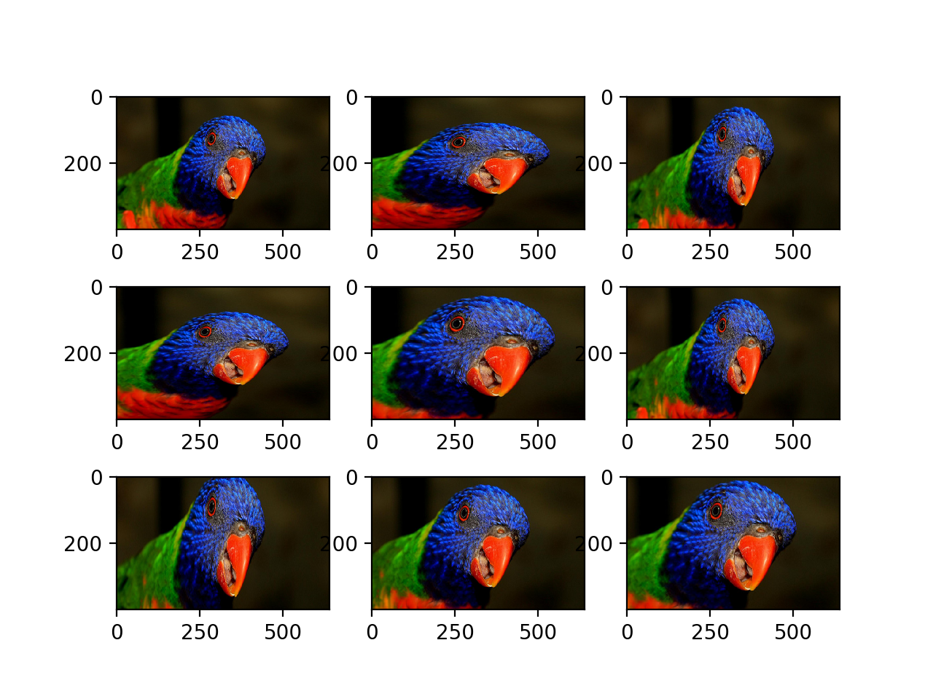
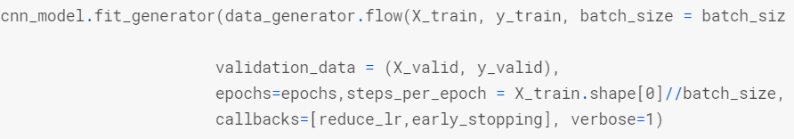
CNN
Parameter Tuning
Pseudo - Labeling
Data Augmentation

Slide 19
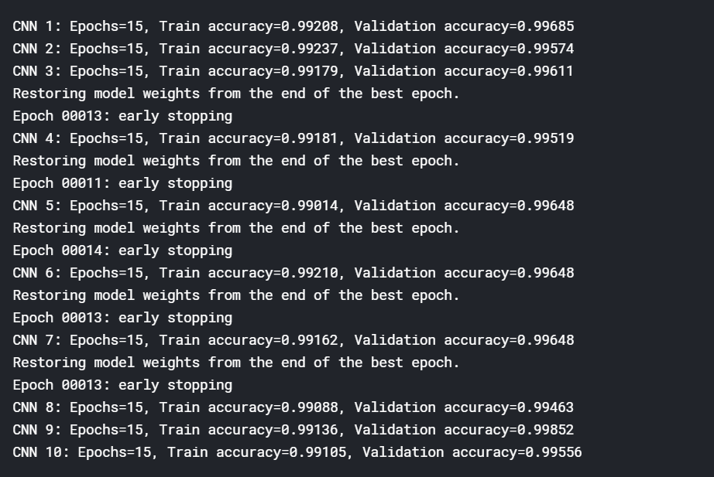
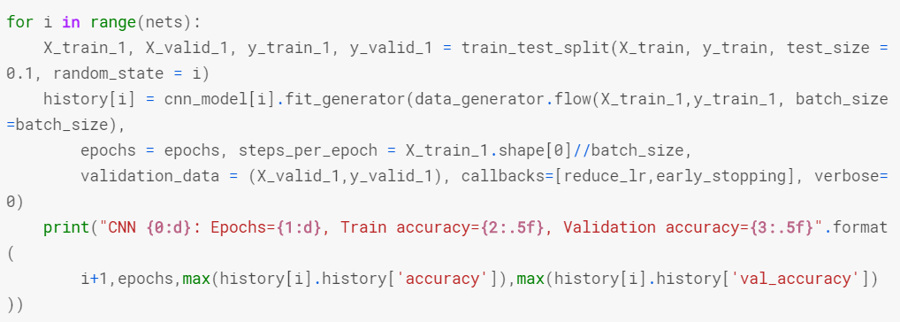
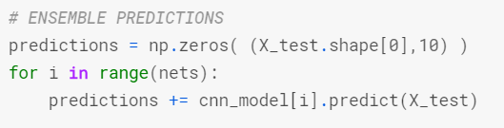
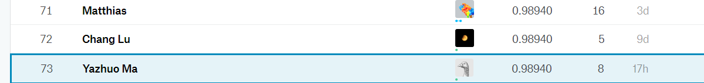

CNN
Ensemble Prediction
Results:

Slide 20
Conclusion
I have learned a lot knowledge about deep learning through this competition.
There are still room to improve my model if I have more time.
Do research is very useful.

Slide 21
Thank You!

